Slide 1
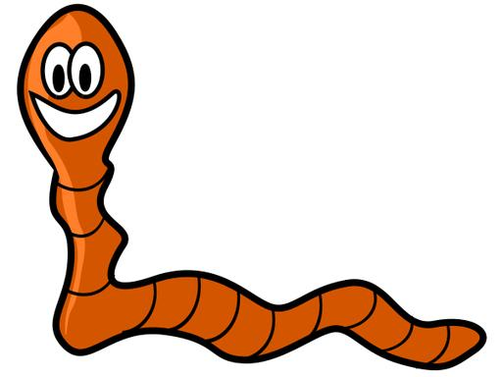
Saving Sam

Slide 2
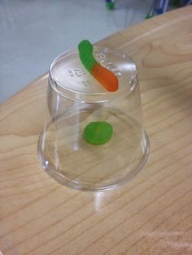
Setting Up the Scenario
Sam is stuck on a boat, and how he got there is not important, but Sam can't swim and the boat is capsized. To get to shore, Sam needs to retrieve a life jacket from underneath the boat so that he can float to shore.

Slide 3
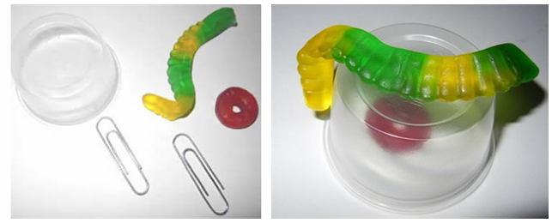
Your Objective
You and your partner's job is to save Sam by retrieving the life jacket from under the boat and putting it on Sam. Unfortunately, the only tools you can use to accomplish this task are paperclips. (2 per group)

Slide 4
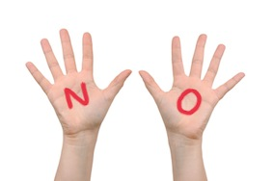
Rules for “Saving Sam”
You cannot touch Sam, the boat, or the life preserver with your bare hands.

Slide 5
Important Things to Know . . .
A gummy worm is used to represent Sam, a gummy life saver is the life preserver and an overturned cup represents the boat.
worms are hermaphrodites, and Sam is technically both boy and girl, which makes the name rather appropriate.

Slide 6
Lab Discussion Questions
1. How did you and your partner figure out how to save Sam?
2. Would it have been easier if you were working alone? Why or why not?
3. Was there a clear leader in your group? Did someone call the shots or make decisions
4. Could Sam be saved if you had only one paperclip?

